Slide 1
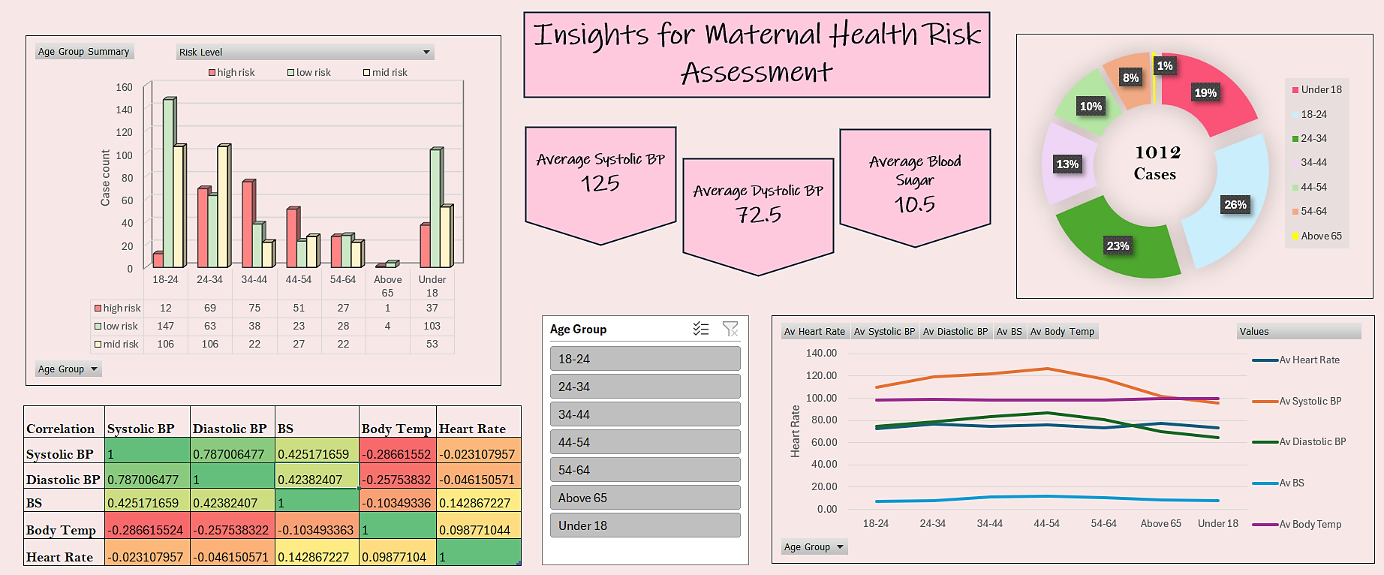
Insights for Maternal Health Risk Assessment
E
D
C
B
A

Slide 2

“The health of a mother reflects the health of a nation.” — Hillary Clinton
SAA and WRA NGO collaborated to analyze data from five underdeveloped hospitals in Southern Asia.
Focusing on vital health indicators like blood pressure, blood sugar, and other key metrics for early-stage mothers (1–2 weeks postpartum).
An Excel-based dashboard was designed to suit the hospitals' limited technological infrastructure and enhance usability.
The dashboard facilitate the identification of mortality risk levels & support proactive decision-making for timely interventions.
KPIs such as Health Metric Averages and Risk Distribution by Age Group enable targeted maternal health interventions.
Patient confidentiality was maintained throughout the data collection and analysis process, adhering to healthcare standards.
A

Slide 3
The bar chart displays the distribution of maternal health risk levels (low, medium, high) across various age groups.
The chart includes a slicer feature that enables users to filter the data by specific age groups which will allow user to focus on age categories, making it easier to identify trends and outliers within those groups.
The highest risk levels are found in the 34-44 age group, suggesting that individuals in this category may face more health complications during postpartum recovery.
The 18-24 age group has the lowest risk levels, indicating that younger mothers may experience fewer health complications postpartum compared to older age groups.
The proportion of high-risk mothers slightly decreases in the age group above 35.
B
A

Slide 4
The donut chart visualizes the age group distribution of cases, providing a clear percentage breakdown of total cases across various age demographics.
Each segment is color-coded for easy differentiation and readability.
The total number of cases were 1012 within the span of a month.
It reveals that most cases are concentrated in the 18-24 and 34-44 age groups, indicating these segments may require more focused healthcare interventions.
The 24–34 age group has the highest number of cases, indicating that this demographic may need the most healthcare resources.
The donut chart underscores a broader trend where younger individuals in underdeveloped areas face a disproportionate burden of maternal health risks, correlating with limited healthcare access and education.
C
B
A

Slide 5
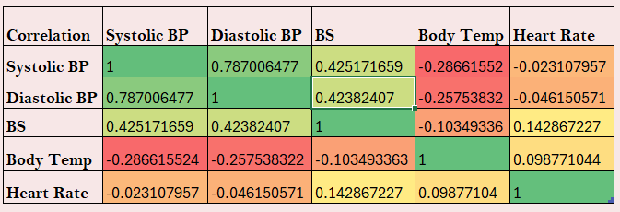
The correlation matrix is created using selected health indicators to identify relationships among these variables.
Blood Pressure and Heart Rate: A moderate positive correlation suggests that higher systolic pressure often coincides with an increased heart rate.
Systolic vs. Diastolic Pressure: A strong positive correlation reflects their close relationship.
Blood Sugar and Blood Pressure: A weak positive correlation indicates that elevated blood sugar slightly aligns with higher blood pressure.
Age and Risk Levels: Older individuals tend to fall into higher-risk categories, shown by a moderate positive correlation.
Heart Rate and Mortality Risk: A weak negative correlation suggests that mortality risk is influenced more by factors other than heart rate.
D
A color-coded scale is included for easy interpretation:
Strong positive correlation: Green (closer to +1)
Strong negative correlation: Red (closer to -1)
Weak/no correlation: Yellow (closer to 0)
C
B
A

Slide 6
The chart can visually analyze and compare patterns or relationships in health metrics across different age groups.
Heart rate remains stable across all age groups, showing minimal cardiovascular stress variation.
Younger groups (18–24) also show elevated blood sugar, hinting at potential gestational diabetes risks.
Stable body temperature across all groups suggests minimal prevalence of fever-related conditions.
Blood pressure increases with age, particularly after 34–44, indicating higher cardiovascular risk in older groups.
Blood sugar spikes in the 34–44 age group, suggesting a need for focused metabolic health interventions.
E
D
C
B
Average Systolic BP 125
Average Blood Sugar 10.5
Average Diastolic BP 72.5
A

